Slide 1

18CSE392T – Machine Learning I
Unit II
Department of Data Science and Business Systems

Slide 2
Topics
Platform for machine learning
Machine learning python libraries
Scikit-learn
Training data – testing data – validation Data
k-fold cross validation
Features
Performance metrics
MSE, accuracy, confusion matrix, precision
Recall, F- score
Linear Regression with multiple variables
Logistic Regression
Spam filtering with logistic regression
Naive Bayes with scikit-learn
Department of Data Science and Business Systems

Slide 3
Platform for Machine Learning
Machine learning platforms provide users with the tools necessary to develop, deploy, and improve machine learning - specifically, machine learning algorithms.
Machine learning platforms automate data workflows, accelerate data processing, and optimize related functionality.
Machine learning platforms and tools combine intelligent algorithms with data, enabling you to derive business insights and deploy new solutions at scale.

Slide 4
Platform for Machine Learning
Benefits
Data-driven business decisions
Improved products and services
Time and energy saved through automation
Shared insights, as users can share data, models, and related information with collaborative tools
Simplified, scalable data science via user-friendly features and out-of-the-box solutions
Optimized experimentation through data visualization, augmentation, and preparation tools

Slide 5
Platform for Machine Learning
Users of Machine Learning Platforms
Though machine learning has traditionally been the domain of professional data scientists, machine learning platforms are becoming increasingly easier to use for developing AI solutions with features such as drag-and-drop capabilities and prebuilt algorithms.
Some platforms also provide resources for non-technical users to understand machine learning models, the data involved, and their impact on the business.
Types of Machine Learning Platforms
Cloud
On-premise

Slide 6
Platform for Machine Learning
Some of Machine Learning Platforms
Google Cloud AI Platform
Azure Machine Learning
IBM Machine Learning
Amazon Machine Learning
Neural Designer
Anaconda
H2O.ai
TensorFlow
Spell
Microsoft Cognitive Toolkit (CNTK)

Slide 7









Machine Learning Python Libraries
Python is one of the most popular programming languages for this task and it has replaced many languages in the industry, one of the reasons is its vast collection of libraries.
Python libraries that are used in Machine Learning are:

Slide 8
ML Python Libraries - Uses
NumPy: For any work with matrices, especially math operations; NumPy is faster and easier to use than most other Python libraries.
SciPy: Scientific and technical computing; for optimization, linear algebra, integration and statistics. SciPy is also very useful for image manipulation.
Matplotlib: Data visualisation; focused on data visualization and primarily used for creating beautiful graphs, plots, histograms, and bar charts
Pandas: - Data set cleaning, merging, and joining. It relies on two types of data structures, one-dimensional (series) and two-dimensional (DataFrame)

Slide 9
ML Python Libraries - Uses
PyTorch: It is mainly used in ML applications that involve natural language processing or computer vision.
Keras: Developing the neural networks for ML models; Keras is flexible, portable, and user-friendly, and easily integrated with multiple functions.
TensorFlow: for high performance numerical computation; It can train and run deep neural networks that can be used to develop several AI applications

Slide 10
ML Python Libraries - Uses
Theano: Focuses on numerical computation; It is able to optimize and evaluate mathematical models and matrix calculations that use multi-dimensional arrays to create ML models
Scikit Learn:
Scikit-learn is a very popular machine learning library that is built on NumPy and SciPy.
It supports most of the classic supervised and unsupervised learning algorithms, and it can also be used for data mining, modeling, and analysis.
Scikit-learn’s simple design offers a user-friendly library for those new to machine learning.

Slide 11
scikit-learn
Simple and efficient tools for predictive data analysis
Accessible to everybody, and reusable in various contexts
Built on NumPy, SciPy, and matplotlib
Open source, commercially usable - BSD license
https://scikit-learn.org/stable/

Slide 12
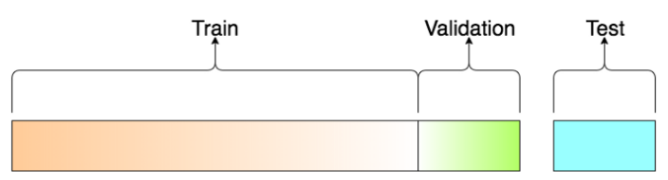
Training Data vs. Validation Data vs. Test Data for ML Algorithms
Effective machine learning (ML) algorithms require quality training and testing data - and often lots of it - to make accurate predictions.
Different datasets serve different purposes in preparing an algorithm to make predictions and decisions based on real-world data.
All three are typically split from one large dataset, each one typically has its own distinct use in ML modeling.

Slide 13
Training Data
This type of data builds up the machine learning algorithm.
The data scientist feeds the algorithm input data, which corresponds to an expected output.
The model evaluates the data repeatedly to learn more about the data’s behavior and then adjusts itself to serve its intended
The sample of data used to fit the model.

Slide 14
Validation Data
During training, validation data infuses new data into the model that it hasn’t evaluated before.
Validation data provides the first test against unseen data, allowing data scientists to evaluate how well the model makes predictions based on the new data.
Not all data scientists use validation data, but it can provide some helpful information to optimize hyperparameters, which influence how the model assesses data.
The sample of data used to provide an unbiased evaluation of a model fit on the training dataset while tuning model hyperparameters.

Slide 15
Testing Data
After the model is built, testing data once again validates that it can make accurate predictions.
If training and validation data include labels to monitor performance metrics of the model, the testing data should be unlabeled.
Test data provides a final, real-world check of an unseen dataset to confirm that the ML algorithm was trained effectively.
The sample of data used to provide an unbiased evaluation of a final model fit on the training dataset.

Slide 16
Cross Validation
Many a times, people first split their dataset into 2 - Train and Test.
After this, they keep aside the Test set, and randomly choose X% of their Train dataset to be the actual Train set and the remaining (100-X)% to be the Validation set, where X is a fixed number(say 80%), the model is then iteratively trained and validated on these different sets.
There are multiple ways to do this, and is commonly known as Cross Validation

Slide 17
Cross Validation
Basically you use your training set to generate multiple splits of the Train and Validation sets.
Cross validation avoids over fitting and is getting more and more popular, with K-fold Cross Validation being the most popular method of cross validation
Cross-validation is a statistical method used to estimate the skill of machine learning models.

Slide 18
k-Fold Cross Validation
Cross-validation is a resampling procedure used to evaluate machine learning models on a limited data sample.
The procedure has a single parameter called k that refers to the number of groups that a given data sample is to be split into.
As such, the procedure is often called k-fold cross-validation.
When a specific value for k is chosen, it may be used in place of k in the reference to the model, such as k=10 becoming 10-fold cross-validation.

Slide 19
k-Fold Cross Validation
Cross-validation is primarily used in applied machine learning to estimate the skill of a machine learning model on unseen data.
That is, to use a limited sample in order to estimate how the model is expected to perform in general when used to make predictions on data not used during the training of the model.
It is a popular method because it is simple to understand and because it generally results in a less biased or less optimistic estimate of the model skill than other methods, such as a simple train/test split.

Slide 20
k-Fold Cross Validation
The general procedure is as follows:
Shuffle the dataset randomly
Split the dataset into k groups
For each unique group:
Take the group as a hold out or test data set
Take the remaining groups as a training data set
Fit a model on the training set and evaluate it on the test set
Retain the evaluation score and discard the model
Summarize the skill of the model using the sample of model evaluation scores
This approach involves randomly dividing the set of observations into k groups, or folds, of approximately equal size. The first fold is treated as a validation set, and the method is fit on the remaining
k - 1 folds.

Slide 21
k-Fold Cross Validation
Configuration of k
The k value must be chosen carefully for your data sample.
A poorly chosen value for k may result in a mis-representative idea of the skill of the model, such as a score with a high variance (that may change a lot based on the data used to fit the model), or a high bias, (such as an overestimate of the skill of the model).
The choice of k is usually 5 or 10, but there is no formal rule. As k gets larger, the difference in size between the training set and the resampling subsets gets smaller. As this difference decreases, the bias of the technique becomes smaller

Slide 22
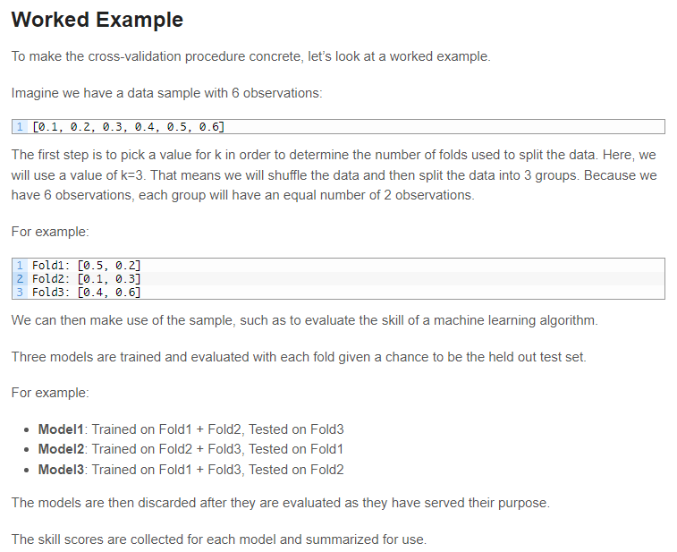
k-Fold Cross Validation

Slide 23
k-Fold Cross Validation
The scikit-learn library provides an implementation that will split a given data sample up.
The KFold() scikit-learn class can be used.
It takes as arguments the number of splits, whether or not to shuffle the sample, and the seed for the pseudorandom number generator used prior to the shuffle.

Slide 24
Performance Metrics
Evaluating the performance of a Machine learning model is one of the important steps while building an effective ML model.
To evaluate the performance or quality of the model, different metrics are used, and these metrics are known as performance metrics or evaluation metrics.
These performance metrics help us understand how well our model has performed for the given data.
Each ML model aims to generalize well on unseen/new data, and performance metrics help determine how well the model generalizes on the new dataset.

Slide 25
Performance Metrics
Mean Square Error (MSE)
Accuracy
Confusion matrix
Precision
Recall
F-score

Slide 26
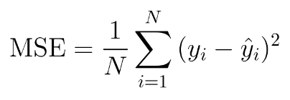
Performance Metrics
Mean Square Error (MSE)
Squares the difference of actual and predicted output values before summing them all instead of using the absolute value.
mean_squared_error function of sklearn.metrics to compute MSE.
To calculate the MSE, you take the difference between your model’s predictions and the ground truth, square it, and average it out across the whole dataset.

Slide 27
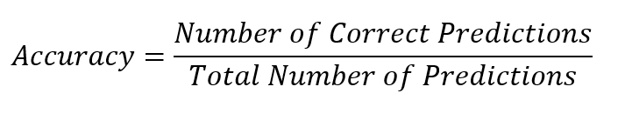
Performance Metrics
Accuracy
The accuracy metric is one of the simplest Classification metrics to implement, and it can be determined as the number of correct predictions to the total number of predictions.
In other words, Classification accuracy is defined as the ratio of number of correct predictions made out of all predictions.

Slide 28
Performance Metrics
Confusion matrix
A confusion matrix is a tabular representation of prediction outcomes of any binary classifier, which is used to describe the performance of the classification model on a set of test data when true values are known.
It is the easiest way to measure the performance of a classification problem where the output can be of two or more type of classes.
A confusion matrix is nothing but a table with two dimensions viz. “Actual” and “Predicted” and furthermore, both the dimensions have “True Positives (TP)”, “True Negatives (TN)”, “False Positives (FP)”, “False Negatives (FN)”

Slide 29
Performance Metrics
Confusion matrix
True Positives (TP)
It is the case when both actual class & predicted class of data point is 1. (In this case, the prediction outcome is true, and it is true in reality, also.)
True Negatives (TN)
It is the case when both actual class & predicted class of data point is 0. (in this case, the prediction outcome is false, and it is false in reality, also.)
False Positives (FP)
It is the case when actual class of data point is 0 & predicted class of data point is 1. (In this case, prediction outcomes are true, but they are false in actuality.)
False Negatives (FN)
It is the case when actual class of data point is 1 & predicted class of data point is 0. (In this case, predictions are false, and they are true in actuality.)

Slide 30
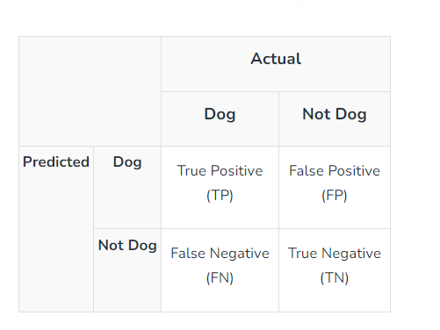
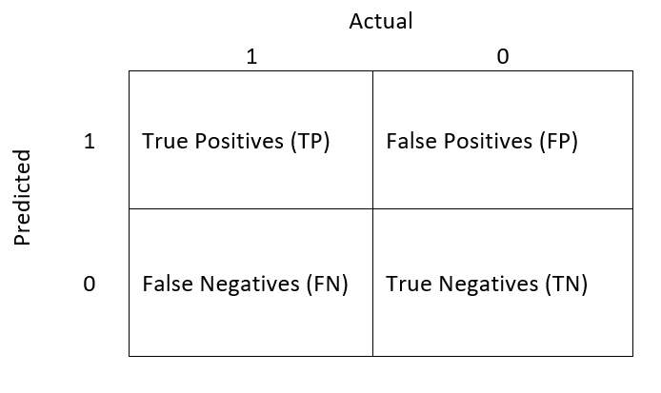
Performance Metrics
Confusion matrix

Slide 31
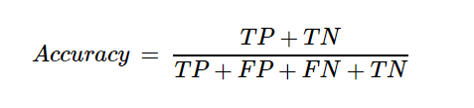
Performance Metrics
Classification Accuracy
In other words, Classification accuracy is defined as the ratio of number of correct predictions made out of all predictions.
confusion_matrix function of sklearn.metrics to compute Confusion Matrix of our classification model

Slide 32
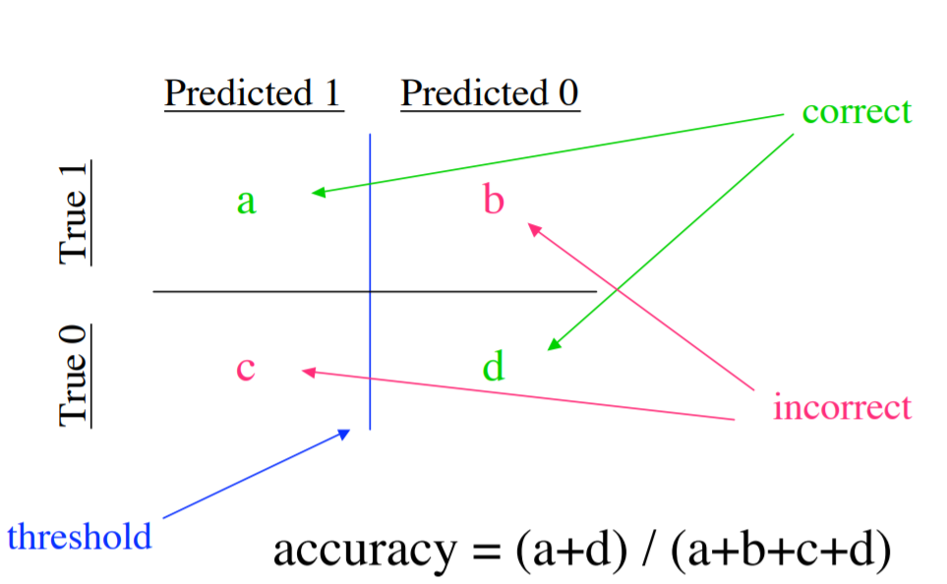
Performance Metrics
Classification Accuracy

Slide 33
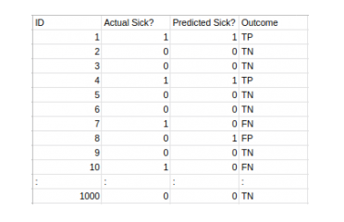

Let’s say you want to predict how many people are infected with a contagious virus in times before they show the symptoms and isolate them from the healthy population (ringing any bells, yet?). The two values for our target variable would be Sick and Not Sick.
The total outcome values are:
TP = 30, TN = 930, FP = 30, FN = 10
So, the accuracy of our model turns out to be:

Slide 34
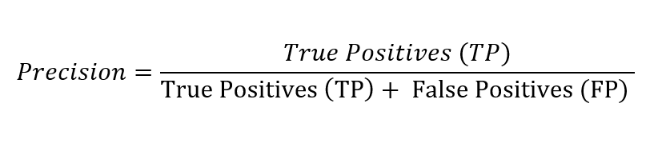
Performance Metrics
Precision - Precision tells us how many of the correctly predicted cases actually turned out to be positive.

Slide 35

Performance Metrics
Recall - Recall tells us how many of the actual positive cases we were able to predict correctly with our model.

Slide 36
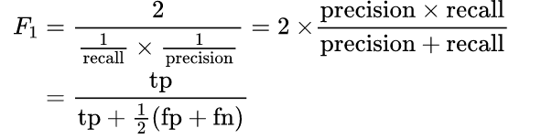
Performance Metrics
F-score
The F-score is a way of combining the precision and recall of the model, and it is defined as the harmonic mean of the model’s precision and recall.
A perfect model has an F-score of 1.

Slide 37
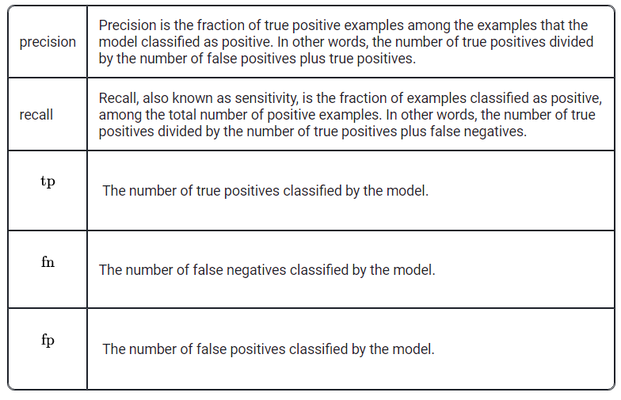
Performance Metrics
F-score

Slide 38
Linear Regression
Linear Regression is a machine learning algorithm based on supervised learning.
It performs a regression task
Linear regression analysis is used to predict the value of a variable based on the value of another variable.
The variable you want to predict is called the dependent variable.
The variable you are using to predict the other variable's value is called the independent variable.

Slide 39
Linear Regression
This form of analysis estimates the coefficients of the linear equation, involving one or more independent variables that predicts the best value of the dependent variable.
Linear regression performs the task to predict a dependent variable value (y) based on a given independent variable (x).
So, this regression technique finds out a linear relationship between x (input) and y (output).
Hence, the name is Linear Regression.
In the figure above, X (input) is the work experience and Y (output) is the salary of a person. The regression line is the best fit line for our model.

Slide 40
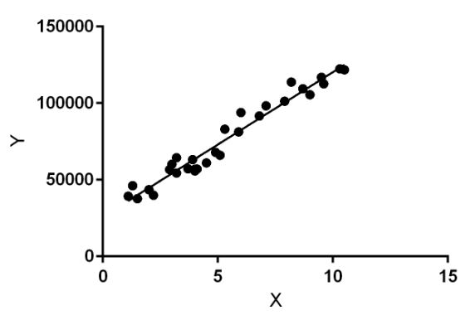
Linear Regression
In the figure, X (input) is the work experience and Y (output) is the salary of a person. The regression line is the best fit line for our model.

Slide 41
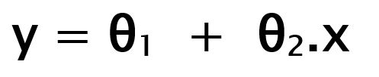
Linear Regression
Hypothesis function for Linear Regression :
While training the model we are given :
x: input training data (univariate – one input variable(parameter))
y: labels to data (supervised learning)
When training the model – it fits the best line to predict the value of y for a given value of x. The model gets the best regression fit line by finding the best θ1 and θ2 values.
θ1: intercept
θ2: coefficient of x

Slide 42
Linear Regression
Once we find the best θ1 and θ2 values, we get the best fit line.
So when we are finally using our model for prediction, it will predict the value of y for the input value of x

Slide 43
Multiple Linear Regression
Multiple linear regression (MLR), also known simply as multiple regression, is a statistical technique that uses several explanatory variables to predict the outcome of a response variable.
The goal of multiple linear regression is to model the linear relationship between the explanatory (independent) variables and response (dependent) variables.

Slide 44
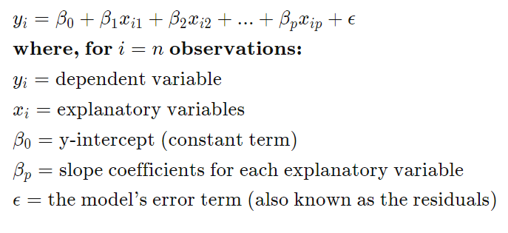
Multiple Linear Regression

Slide 45
Logistic regression
Logistic regression is one of the most popular Machine Learning algorithms, which comes under the Supervised Learning technique.
It is used for predicting the categorical dependent variable using a given set of independent variables
Logistic regression predicts the output of a categorical dependent variable.
Therefore the outcome must be a categorical or discrete value. It can be either Yes or No, 0 or 1, true or False, etc. but instead of giving the exact value as 0 and 1, it gives the probabilistic values which lie between 0 and 1.

Slide 46
Logistic regression
Linear Regression is used for solving Regression problems, whereas Logistic regression is used for solving the classification problems.
In Logistic regression, instead of fitting a regression line, we fit an "S" shaped logistic function, which predicts two maximum values (0 or 1).
The curve from the logistic function indicates the likelihood of something such as whether the cells are cancerous or not, a mouse is obese or not based on its weight, etc.

Slide 47
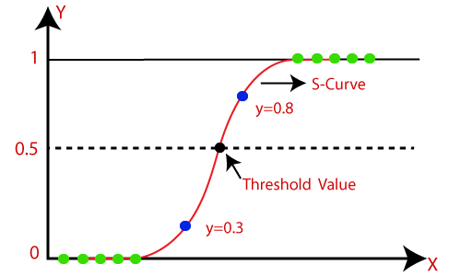
Logistic regression
Logistic Regression can be used to classify the observations using different types of data and can easily determine the most effective variables used for the classification. The below image is showing the logistic function:

Slide 48
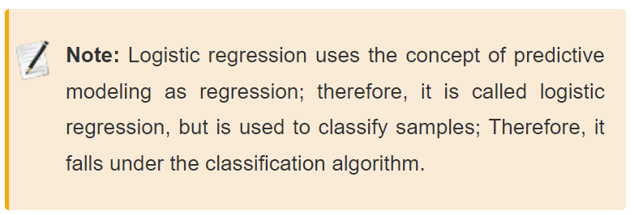
Logistic regression

Slide 49
Logistic regression
Logistic Function (Sigmoid Function):
The sigmoid function is a mathematical function used to map the predicted values to probabilities.
It maps any real value into another value within a range of 0 and 1.
The value of the logistic regression must be between 0 and 1, which cannot go beyond this limit, so it forms a curve like the "S" form.
The S-form curve is called the Sigmoid function or the logistic function.

Slide 50
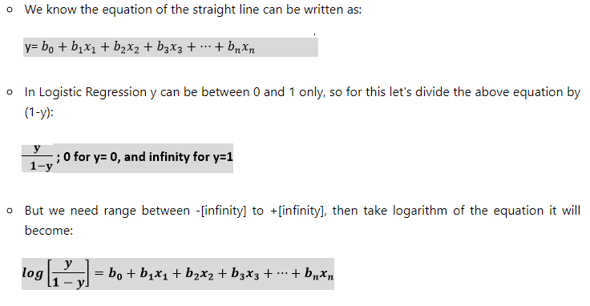
Logistic regression
Logistic Function (Sigmoid Function):
The Logistic regression equation can be obtained from the Linear Regression equation. The mathematical steps to get Logistic Regression equations are given below:

Slide 51
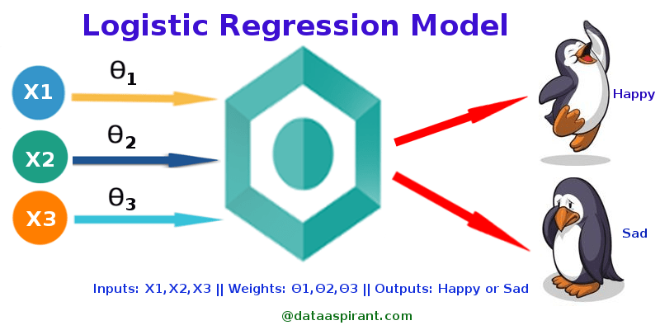
Logistic regression
Example:
To predict whether an email is spam (1) or (0)
Whether the tumor is malignant (1) or not (0)

Slide 52
Logistic regression
Types: On the basis of the categories, Logistic Regression can be classified into three types:
Binomial: In binomial Logistic regression, there can be only two possible types of the dependent variables, such as 0 or 1, Pass or Fail, etc.
Multinomial: In multinomial Logistic regression, there can be 3 or more possible unordered types of the dependent variable, such as "cat", "dogs", or "sheep“
Ordinal: In ordinal Logistic regression, there can be 3 or more possible ordered types of dependent variables, such as "low", "Medium", or "High".

Slide 53
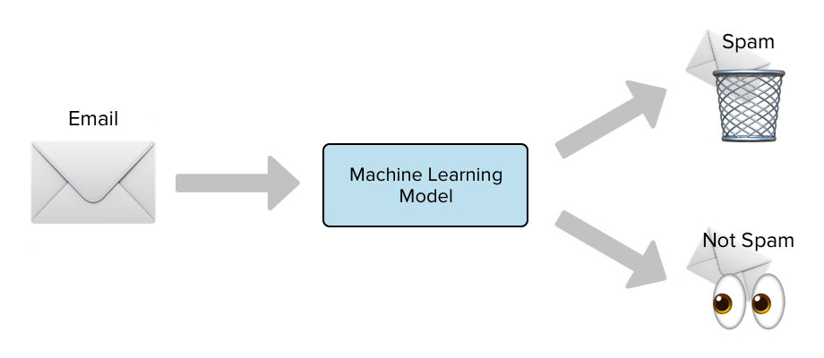
Spam Detection with Logistic Regression

